Slide 1
A mini project on mall customers segmentation
presented by:-
Narmula vamshikrishna

Slide 2
Business goal:-
To predict the different types of the customers who visits the mall for different purposes using the past data.
The Segmentation of the Customers are given based on different features and select the customers whether eligible for any discounts or not.
By analyzing the past data we have to predict the customer belongs to which segment.
By analyzing we can help the malls to meet the needs of the customer belonging to different segments and it increases the business of the malls.

Slide 3
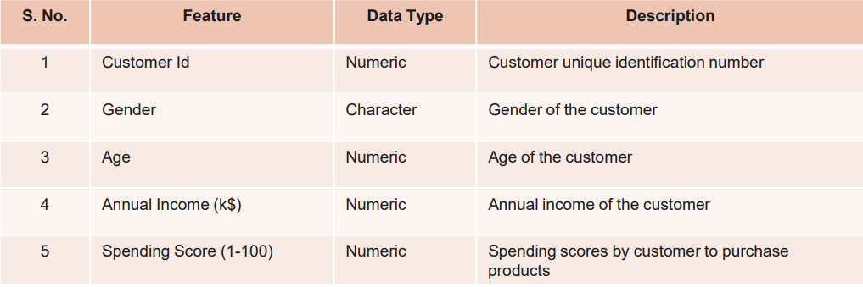
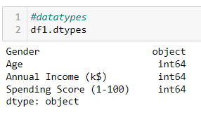
Data source and datatypes
The structure of the given dataset :
Rows = 200
Columns = 4
Here the Feature ‘Customer ID’ was dropped and analysed further.
The datatypes of the 4 features are shown in the picture which has
3 – Numeric columns
1 – Non_Numeric Columns

Slide 4
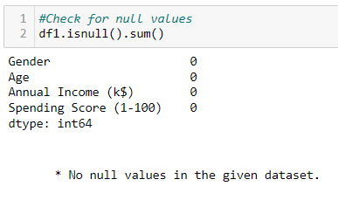
Data preprocessing : Imputation of missing values
Check for the Null values in the given dataset.
There are no null values in the given dataset.
Check for Special characters in the given dataset.
There are no special characters in the given dataset.
Outlier Treatment for the given dataset.
There were mostly no outliers found in the given dataset except only 1 outlier in ‘Annual Income (k$)’ feature.
I used boxplot to check for outliers.

Slide 5
Eda process:-
Loading the data and reading the data.
Check for the structure.
Check for the datatypes
Check for information
Check for summary
Check for null values.
No null values in the given dataset.
Checked for any special characters present in the data found no special characters.
Data Visualization.

Slide 6
Feature engineering Techniques
Converting the non-numeric column to categorical column.
Using labelencoder converting the categorical column to numerical column.
Using standardization scaling the data.
Finding the correlation of scaled features.
No need to split the data into train and test samples.
Only 2 features are used to check for the formation of clusters.
The features Annual Income(K$) and Spending Score(1-100) are used to find the type of customer whether eligible for any discounts or not.

Slide 7
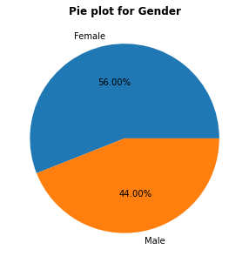
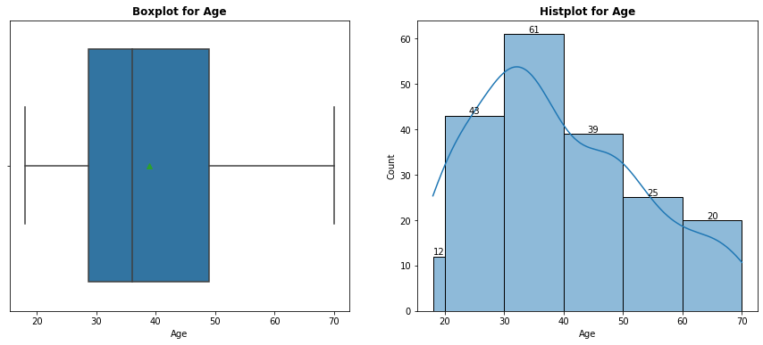
Visualizations:-
UNIVARIATE
Interpretation:-
There are more 'Female' customers that is 56.0% compared to 'Male' customers that is 44.0% in the given data.
The Mean is greater than Median so, the distribution is skewed to the right.
No outliers found in the given feature.
The customers with Age group between 30-40 are more in numbers followed by age group between 20-30.

Slide 8
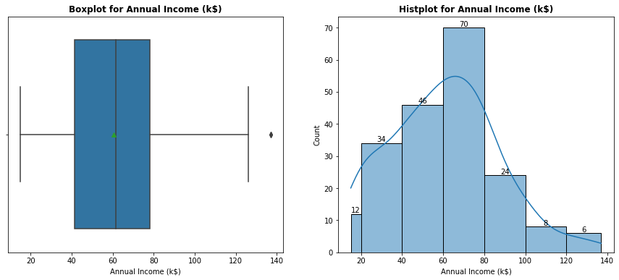
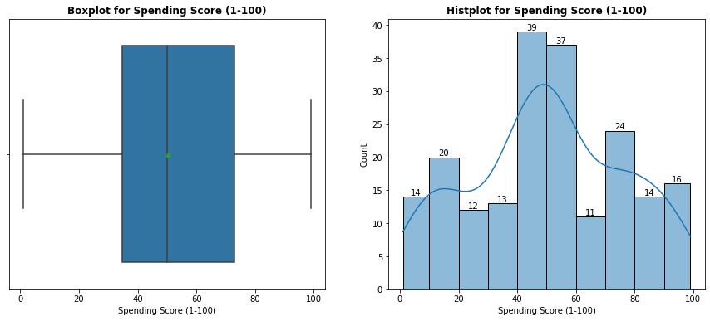
UNIVARIATE
Interpretation:-
For Annual Income (k$) Mean is less than Median so, the distribution is skewed to the Left .
Only 1 outlier found in the given feature.
The customers with Annual Income (k$) between 60-80 are more in numbers followed by age group between 40-60.
The data looks Normally distributed.
For Spending Score (1-100) Mean is Greater than Median so, the distribution is skewed to the right.
No outliers found in the given feature.
The customers with Spending Score (1-100) between 40-50 are more in numbers followed by age group between 50-60.
The data is not distributed Normally.

Slide 9
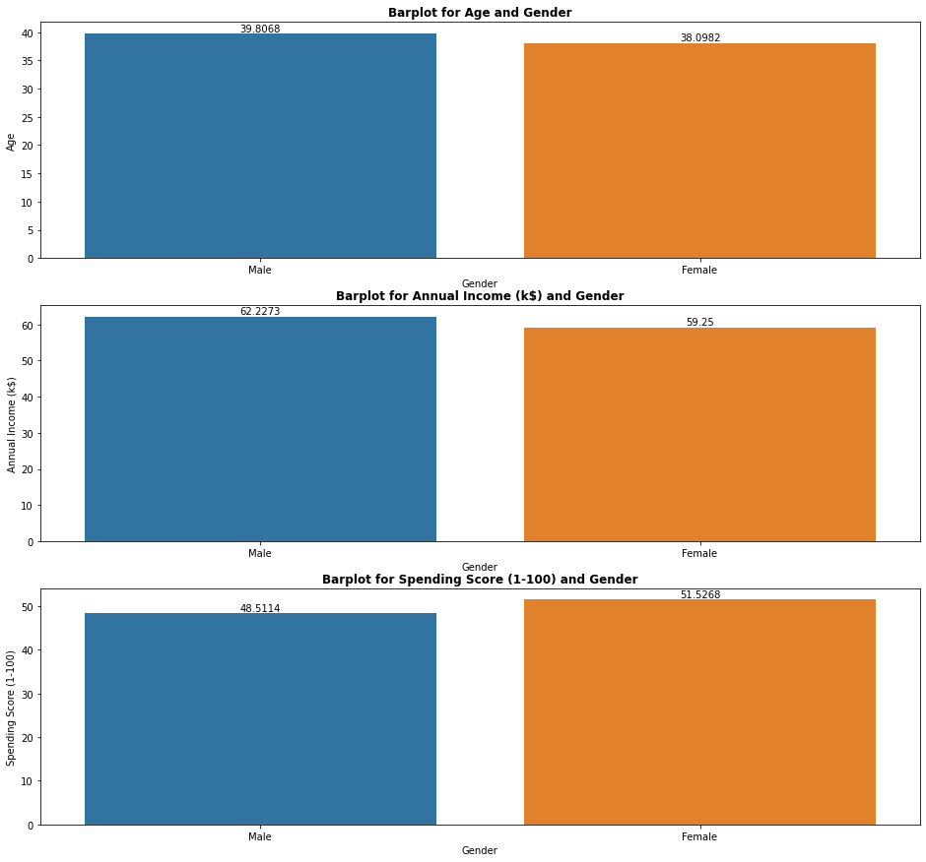
bivariate
Interpretation:-
For the Gender of 'Male' customers the average 'Age’ that is 39.80 more than Female customers average age that is 38.09.
For the Male customers the Average Annual Income (K$) that is 62.22 is more than the female customers Annual Income (k$) that is 59.25.
For the Female customers the average Spending score that is 51.52 is more than the Male customers average spending score that is 48.51.

Slide 10
Model building
For different customer segmentation 3 algorithms are used
KMeans Clustering
Agglomerative Clustering
DBSCAN clustering
As the problem statement is ‘Customer Segmentation’ which is an unsupervised data I have used these 3 clustering models.
I have used these clustering techniques to check which model gives the better formation of Customer segmentation clusters.

Slide 11
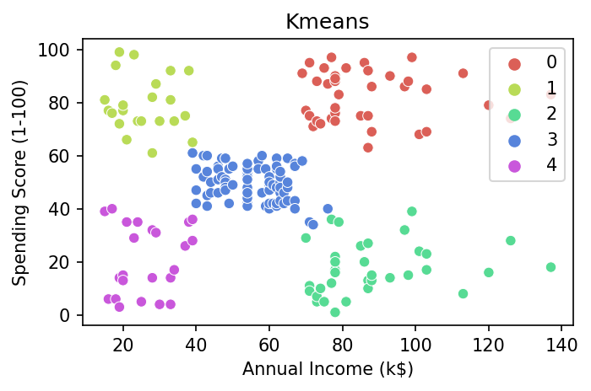
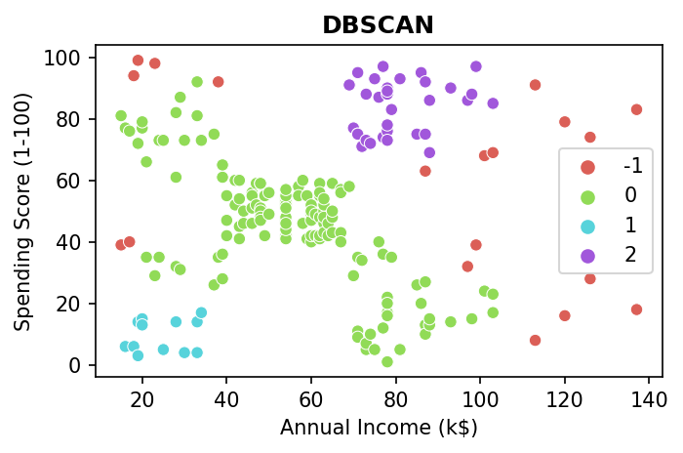
Kmeans:-
In KMeans cluster to find the optimal k I used the Elbow curve and silhouette score and got the optimum k value as 5.
The formation of clusters is proper but some of the datapoints of one cluster are close to another cluster.
we cannot find outliers using KMeans.
DBSCAN:-
In DBSCAN using the hyperparameters Epsilon with minimum samples found the clusters and the outliers.
The formation of clusters are not proper and cluster points are nearer to another cluster.
The outliers can be detected which are in red dots in these DBSCAN clustering.

Slide 12
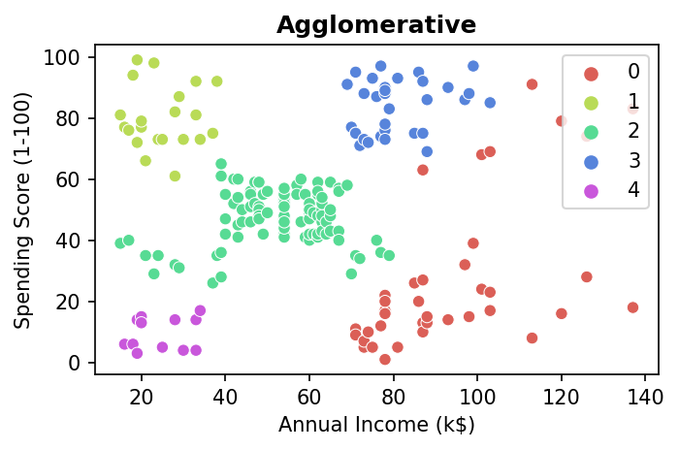
AGGLOMERATIVE:-
In Agglomerative clustering using the dendrogram with distance as ‘Euclidean’ and linkage as ‘Word’ with the threshold line found the number of clusters(n).
The formation of clusters is proper but some of the datapoints of one cluster are close to another cluster.
we cannot find outliers using Agglomerative clustering.

Slide 13
Final Conclusion:-
KMeans clustering algorithm is the best clustering algorithm for our dataset to segment customers into different groups.
We have found the customers are divided into 5 segments by the KMeans cluster.
cluster == 0 : name = 'High Income and High Spending Scores Customers. Can be Target for Sales!’
cluster == 1 : name = 'Low Income but High Spending Scores Customers!'
cluster == 2 : name = 'High Income but Less Spending Scores Customers!'
cluster == 3 : name = 'Average Income and Average Spending Scores Customers!'
cluster == 4 : name = 'Low Income and Low Spending Scores Customers!'

Slide 14
Thank you

